Slide 1
Welcome to the
7th Meeting
Going forward
Jeroen van Lange - The Blockchain Today

Slide 2
Todays Program
Crypto markets at turning point (BTC.D)
Bitcoin correction over ?
Portfolio allocations
Alt-coins (small caps, mid caps)

Slide 5
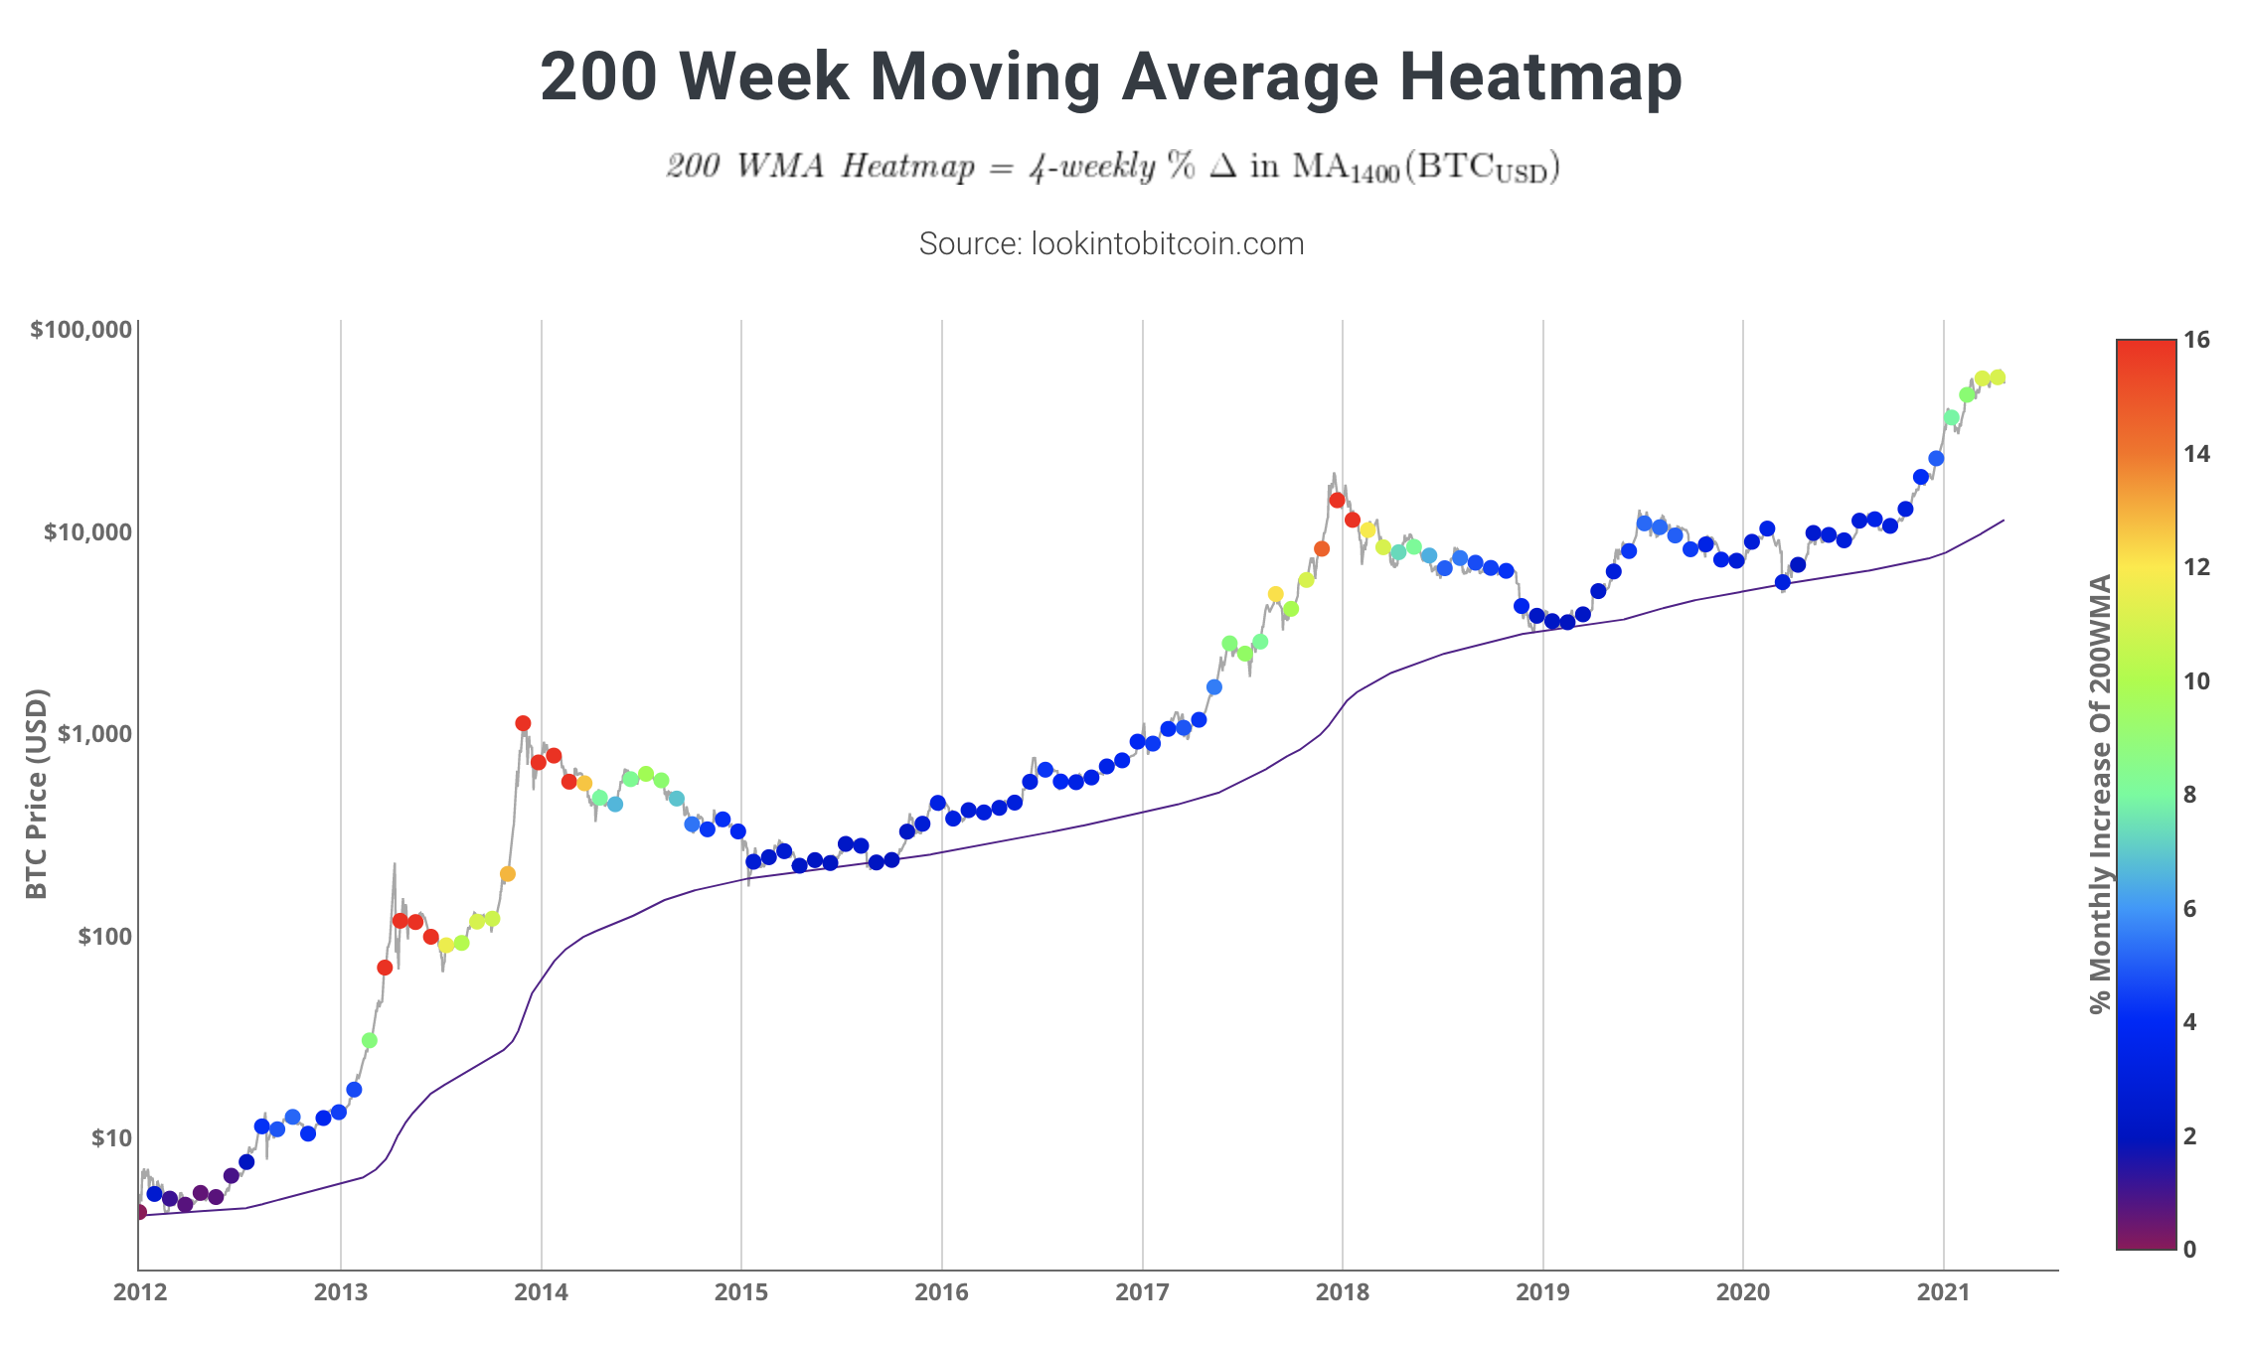
Bitcoin correction over ?
Short-term correction
Bitcoin fundamentals look strong
Macro charts point to more upside
50 DMA (Key level) Short term

Slide 7
Portfolio allocations
Keep it simple
Be careful with a too large divided portfolio of alt-coins. (keeping track)
e.g. betting on 20 alts to hope for 1 runner. The loss of the other 19 make up for the profits of the 1
Separate it in terms of technology : - Smart contracts (ETH, ADA, DOT) - Oracles (LINK, BAND) - DeFi (Aave, Comp, YFI)

Slide 8
Portfolio allocations
Bull market switch between BTC/ALTS
Bear market mainly positioned in BTC & Stable coins
In a bull market everything trends up (BTC/ALTS)
But you want low-risk and maximise profits so only position in ALTS when they outperform BTC

Slide 9
Some shiners

Slide 11
Let’s have a look at some alt-coin charts

Slide 14
Let’s analyse these real-time
Any suggestions ?
Aave, BAND, Cardano (ADA), Chainlink (LINK), Compound, Cosmos, Dash, Digibyte, Enjin, Elrond (EGLD), EOS, Ethereum, 0x, Polkadot (DOT), REN, XRP, Stellar (XLM), Uniswap (UNI), Vechain (VET), Yearn Finance (YFI), Zcash, Monero

