Slide 1
Welcome to
5th Meeting
Current market situation
& Opportunities
Jeroen van Lange - The Blockchain Today

Slide 2
Todays program
Current market situation
Bitcoin dominance (continue to decrease ?)
Alt-coins
Bitcoin top coming ? (pi cycle top, Monthly candles)
Where are the opportunities ?

Slide 3
Bitcoin dominance

Slide 4
BTC.D
Until reversal signal on mid-term timeframe (4h or Daily)
Position into Alt-coins

Slide 5
ETH/BTC

Slide 6
ETH/BTC
Flipped resistance into support
As long as we’re holding 0.035 I remain bullish
Next target middle of the channel (0.04 - 0.041)
Re-entry point could be 0.035BTC

Slide 7
LINK/BTC

Slide 8
LINK/BTC

Slide 9
DOT/BTC

Slide 10
Is Bitcoin topping out ? (Pi cycle top)

Slide 11
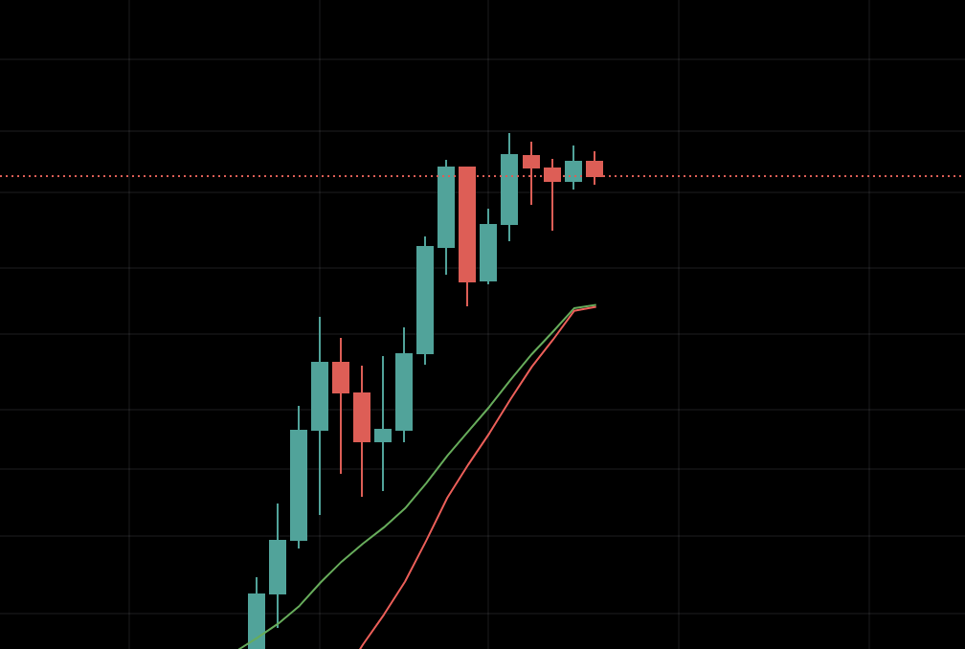
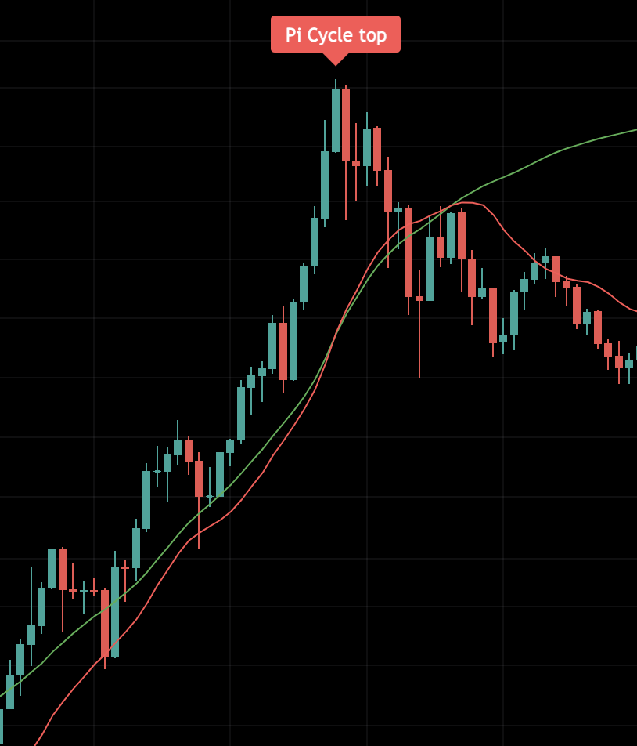
Let’s first look at price behaviour

Slide 12
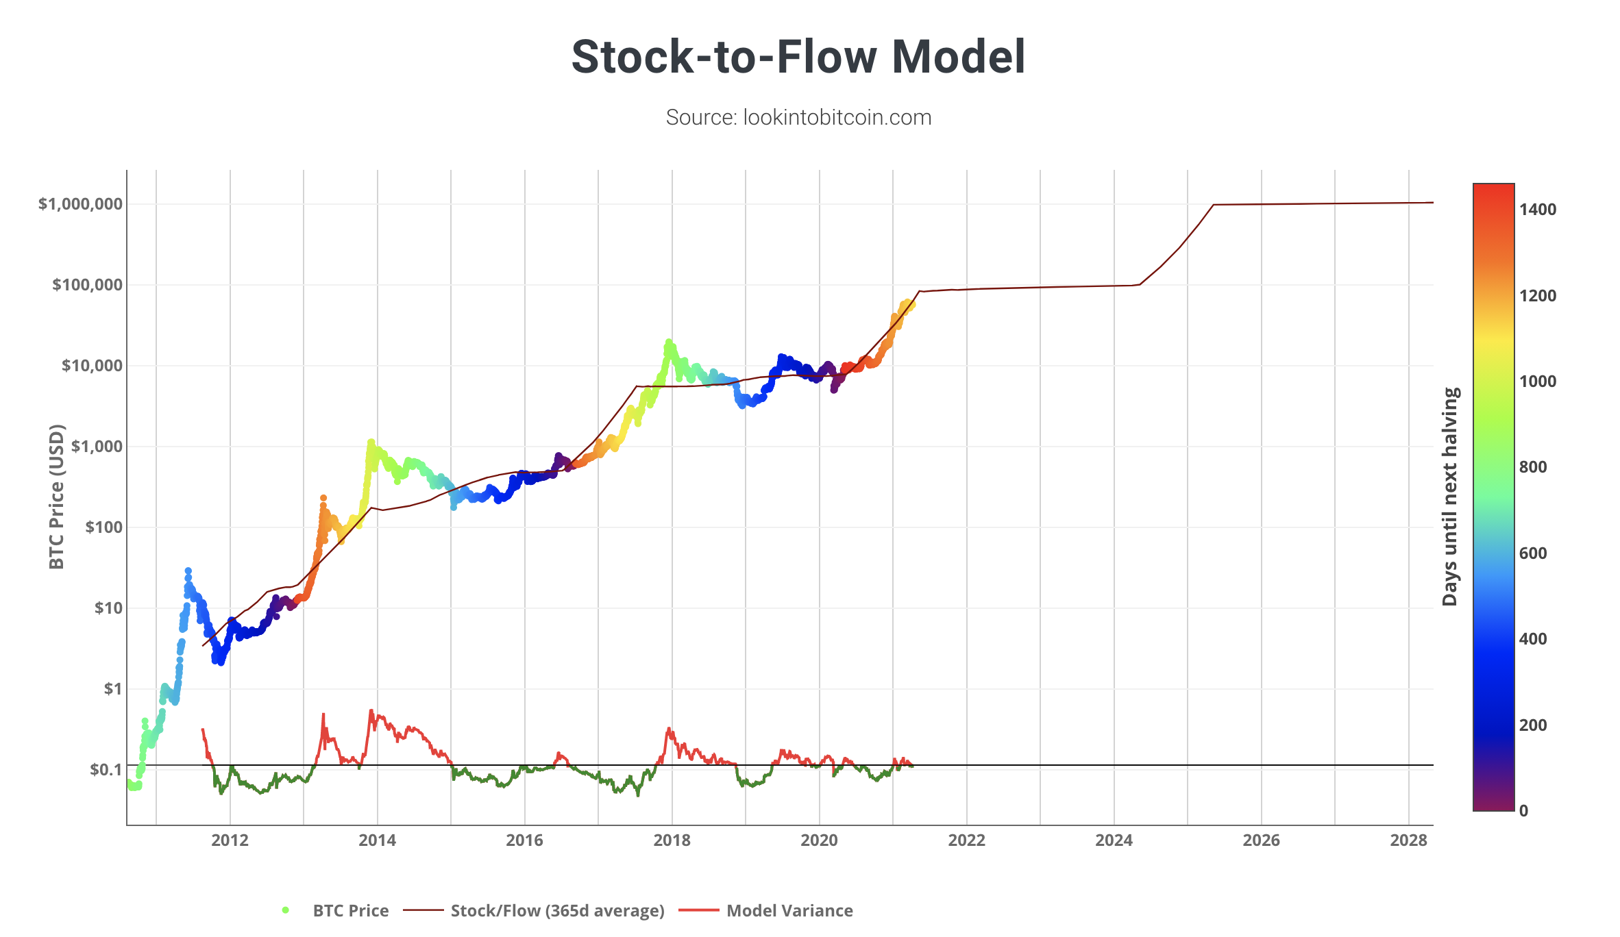
Stock to flow

Slide 13
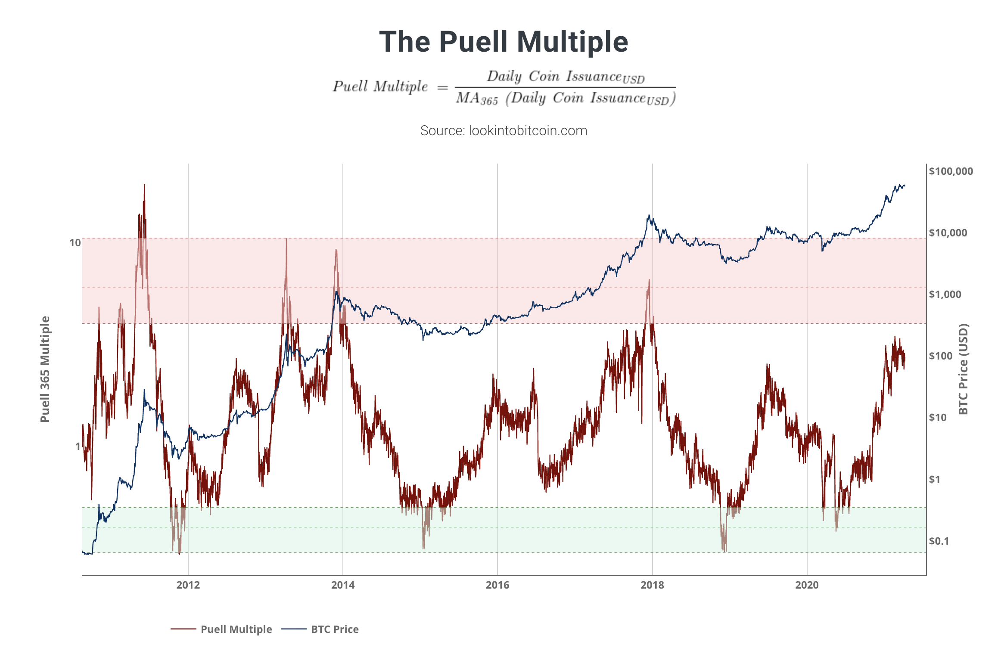

Slide 14
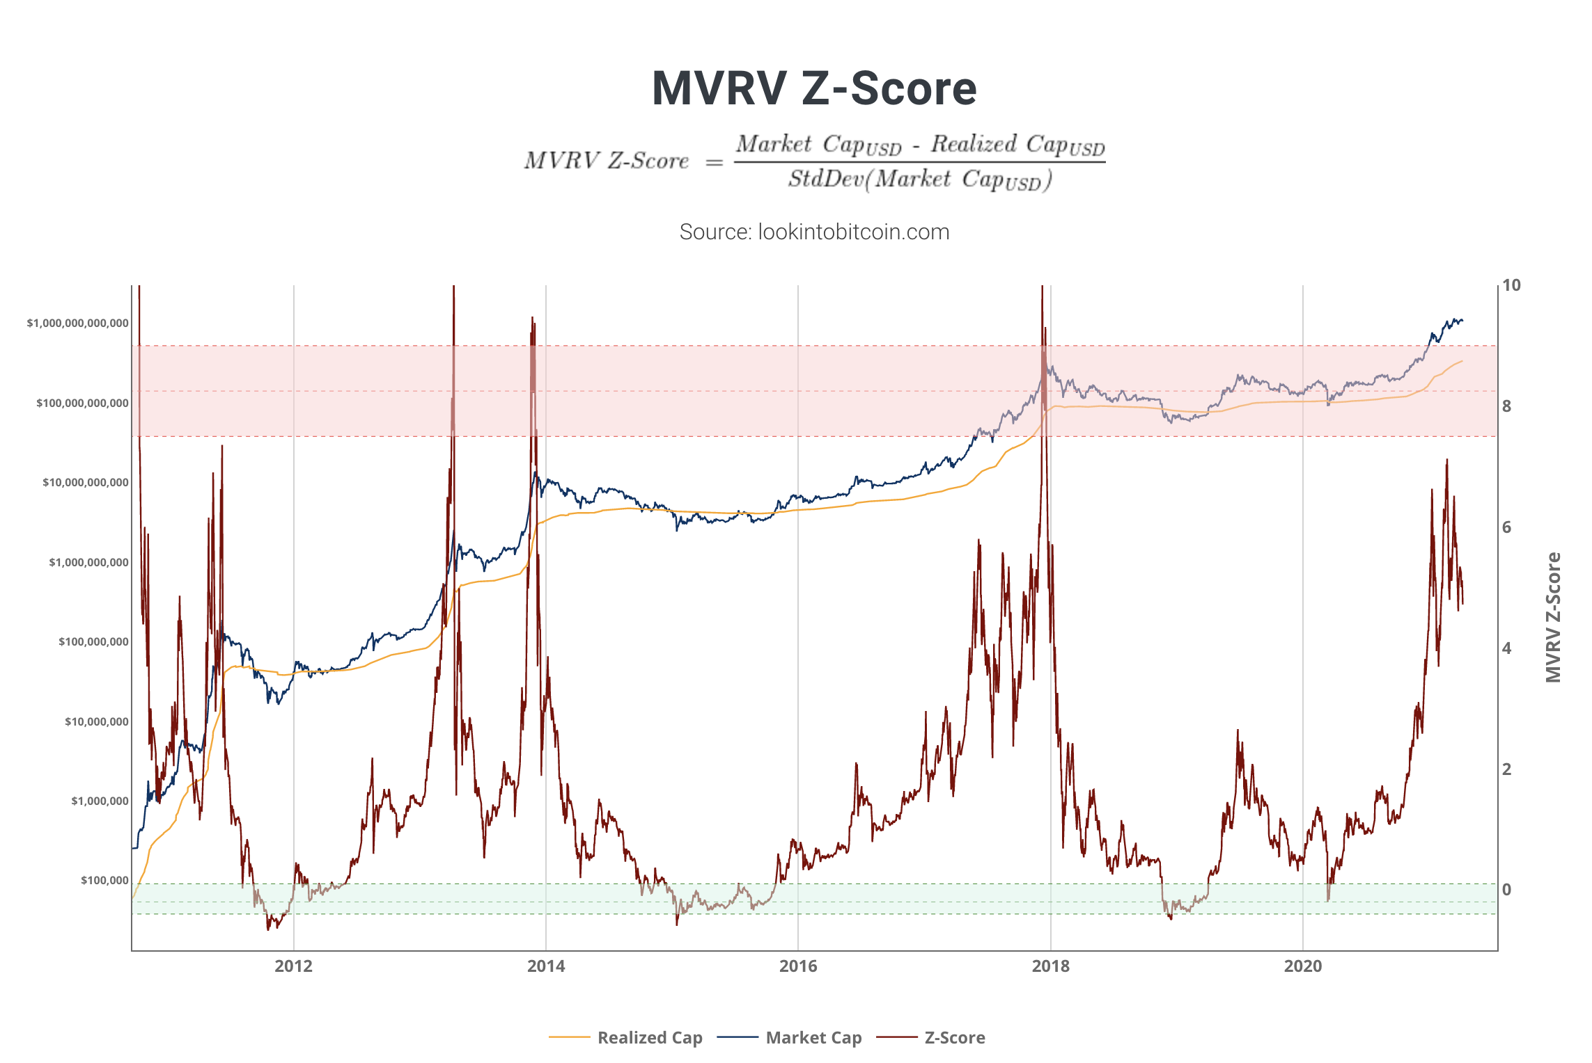

Slide 15
This time it’s different
Is it ?
Market structure looks different
Other metrics are not confirming a cycle-top
Could it still signal a top ?

Slide 16
Where is Bitcoin right now ?
Bullish or bearish ?
Even in a bull-market we can’t just only go up
Consolidating
Declining resistance RSI (Daily)
20DMA (less significant sideways)

Slide 19
Let’s zoom a little bit out

Slide 21
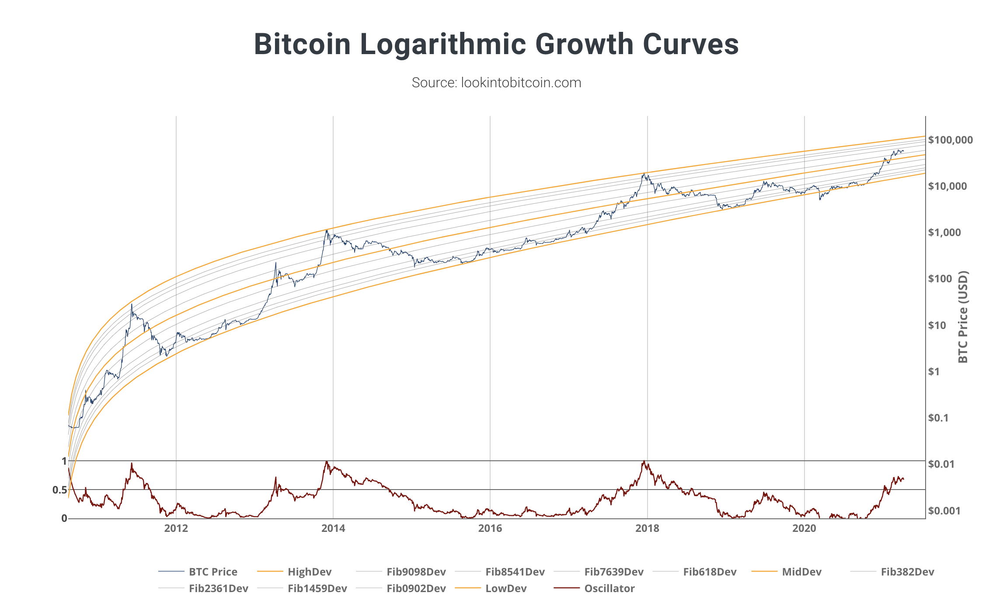

Slide 22
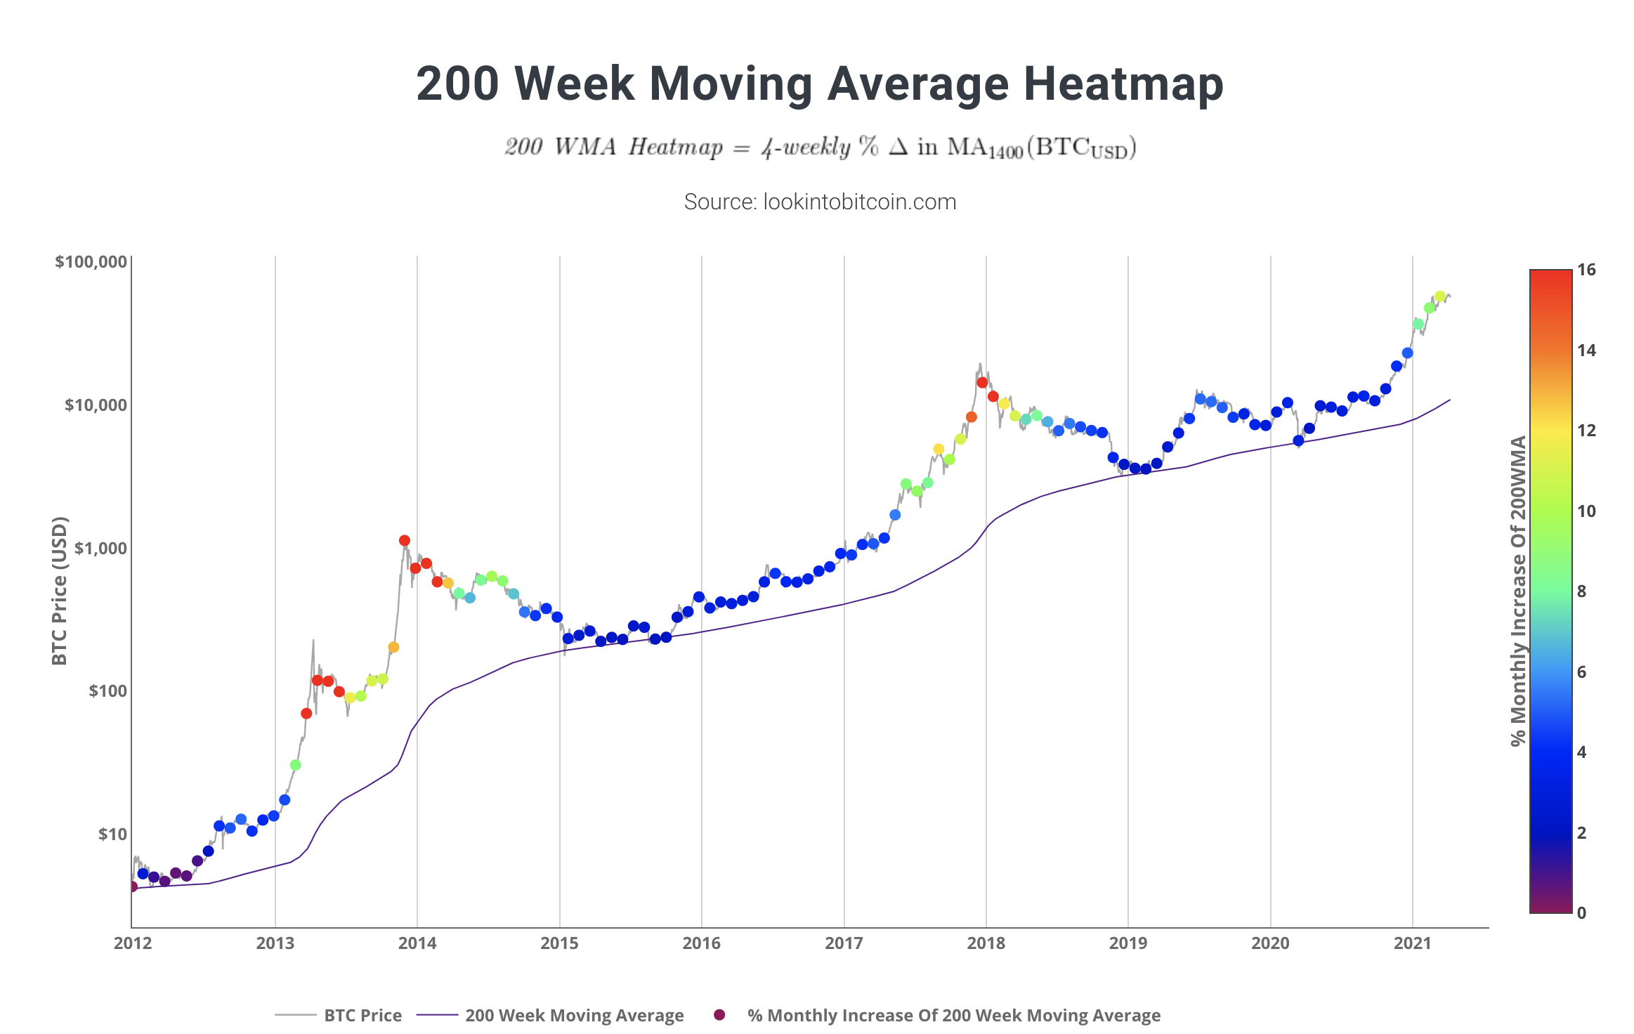

Slide 24
SP500 breakout

Slide 25
SP500 2007
Right before 2008 crisis

Slide 26
The VIX (Volatility Index)

Slide 27
Summary
Bitcoin is consolidating and not bullish until momentum break
Alt-coins are still positioned
Bitcoin hasn’t reached cycle top (most likely)
SPX aligning with BTC
SPX can be used for BTC selling pressure
New alt opportunities

Slide 28
Litecoin (LTC/BTC)

Slide 29
Monero (XMR/BTC)

